Slide 1
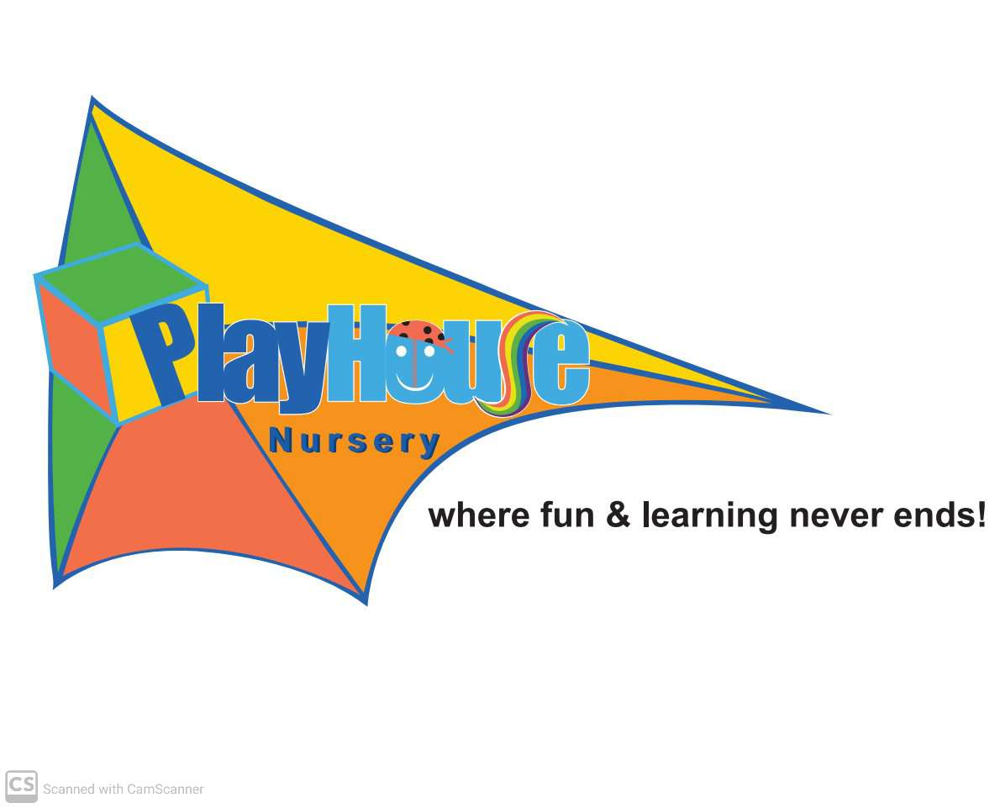
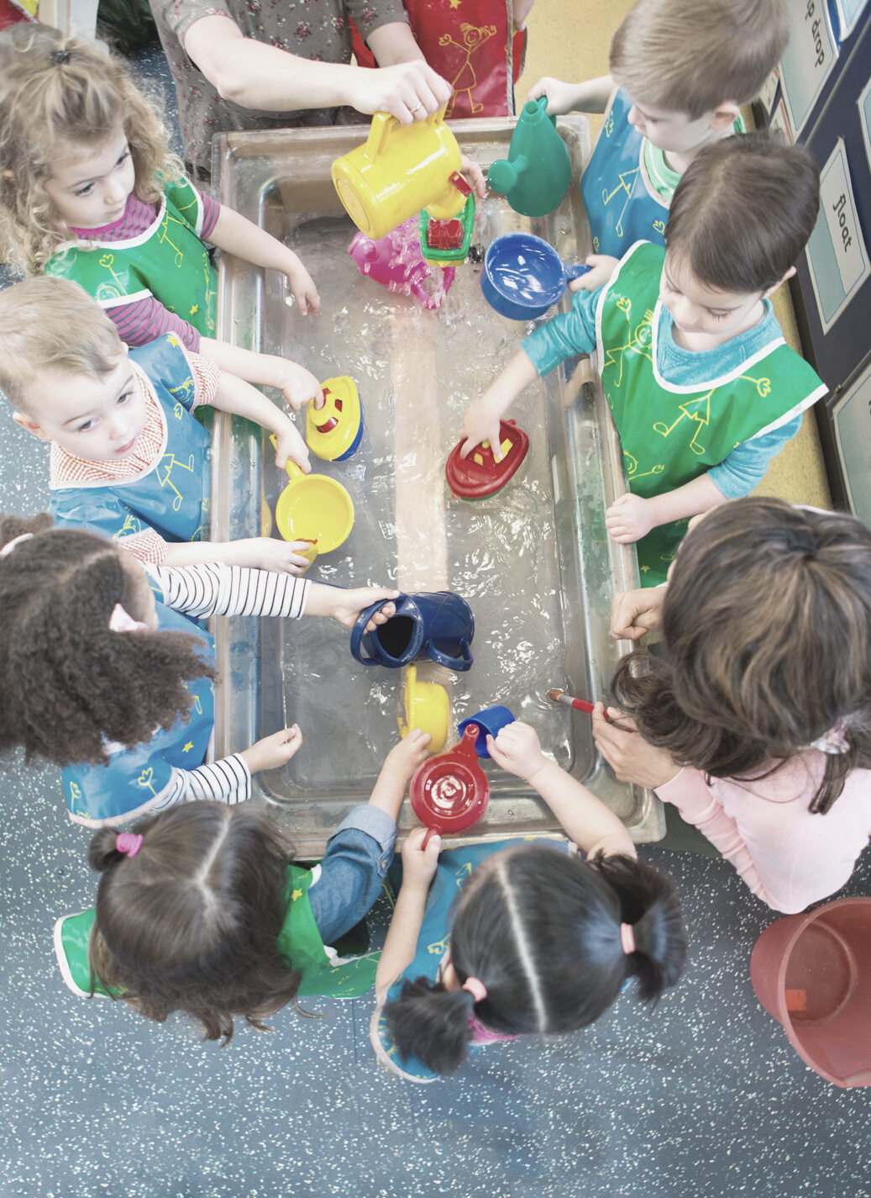


PLAYHOUSE NURSERY
Early years center

Slide 2

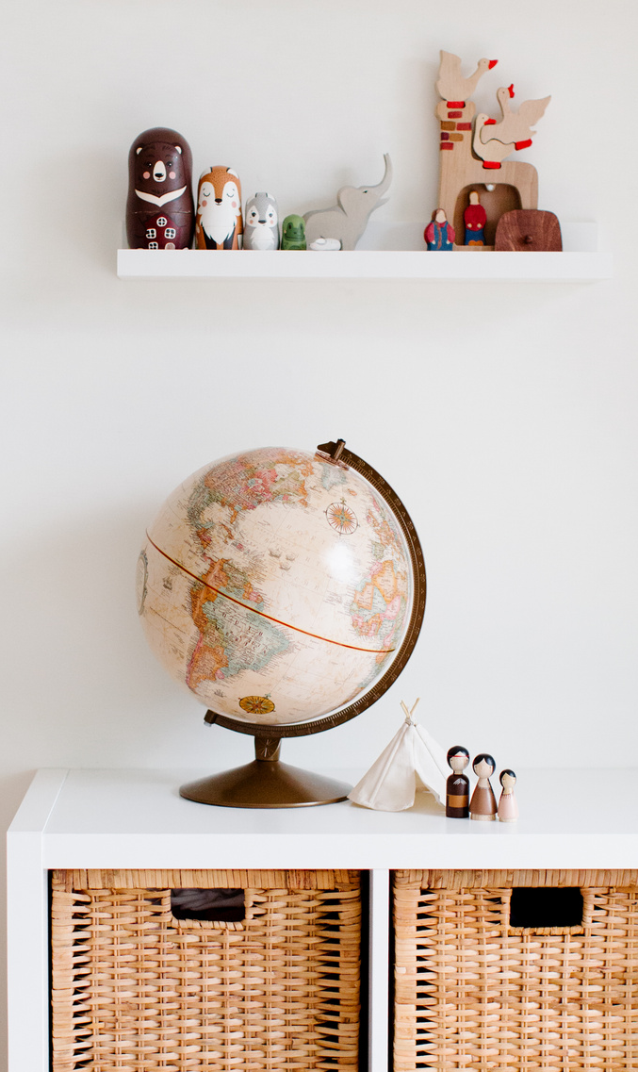



OUR CURRICULUM
Our goal is to maximize each child's learning potential by stimulating intellectual growth. For almost two decades, Playhouse Nursery has earned itself a reputation for excellence in early education. The nursery has various branches operating across Abu Dhabi and Dubai which incorporate the British (EYFS) curriculum to give educational instructors a universal set of principles in supporting the social and academic development of children under the age of five.
Childcare facilities include both preschool and daycare services managed by our well-trained staff of CACHE-certified English teachers, who work to ensure that childrens' individual strengths and interests are nurtured with a range through a range of play-based activities.
Type: Pre-K Education, Early Years Center, Nursery
Location : UAE, Abu Dhabi , Dubai
Trade License: Mainland
Year Established: 2001
No. Employees: 40
AED 3.7M (USD 1M)
Page 3

Slide 3

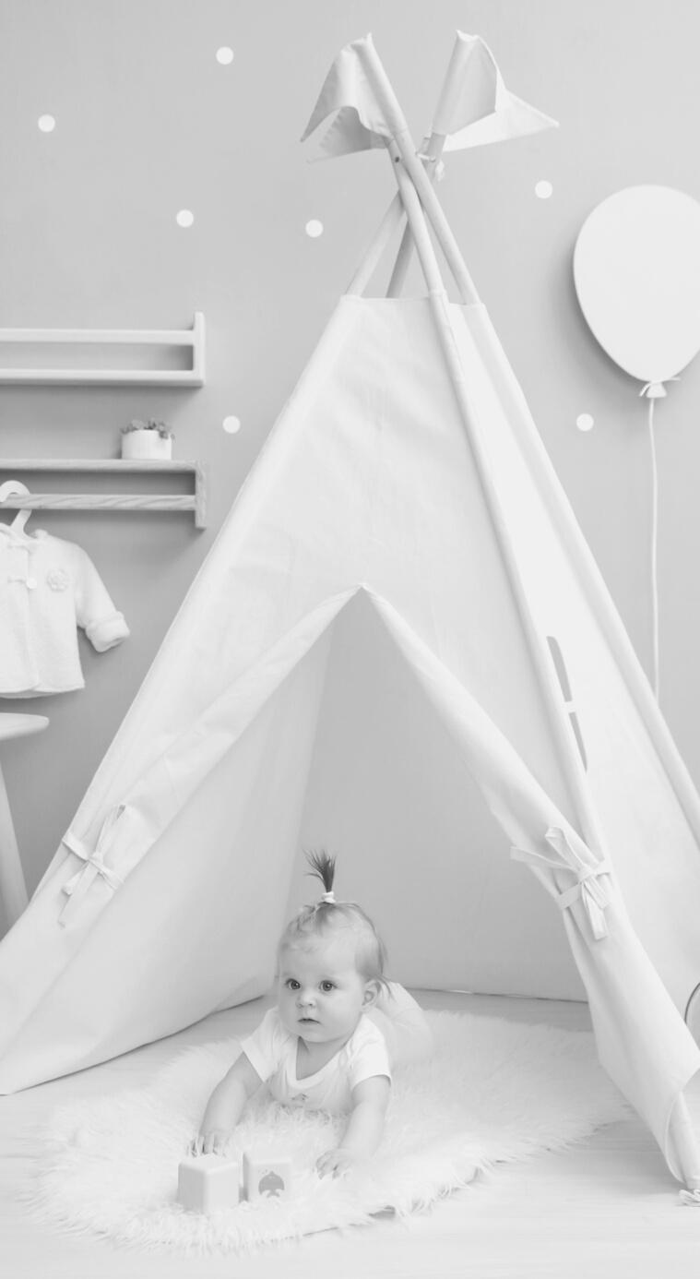
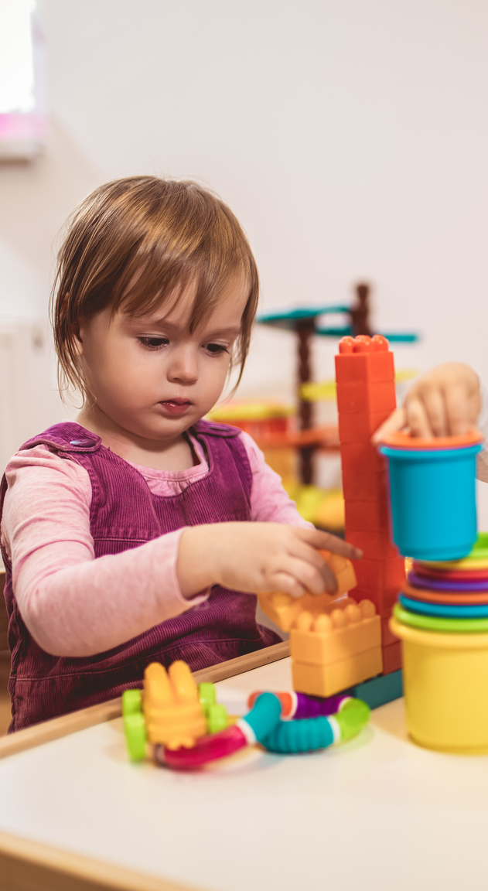
CURRICULUM
EYFS British curriculum
At Playhouse Nursery we follow EYFS Curriculum which guides the learning and teaching process and helps us to establish an optimum learning environment in our classes. We are the best EYFS nursery Dubai. As the best day care in Dubai, we believe that to engage, achieve and make positive contributions students must be healthy, secure, and safe. We value all of these needs and understand their contribution to the development of happy students in an enjoyable, encouraging, and stimulating atmosphere. The learning environment combines high standards with a broad and rich curriculum. We use a variety of play-based and structured activities striking a fine balance between both teacher-led and student-initiated play. Play underpins all development and learning for young children. Most children play spontaneously and it is through play that they develop intellectually, creatively, physically, socially, and emotionally.
We have programs developed for different age group of children. The programs have been created after careful consideration and identification of the requirement of children belonging to the specific age groups.
Page 5

Slide 4





Young children benefit from discovering art by doing and exploring various art forms and materials. They are naturally curious and love to experiment with colors, textures, and art tools that provide opportunities and encouragement for sharing their thoughts, ideas, and feelings through a variety of activities.
01
EYFS PRIME AREAS
PERSONAL, SOCIAL AND EMOTIONAL DEVELOPMENT
This is an important area in child development as it influences every child's emotional well-being as well as helps them to build relationships, self-confidence, self-awareness, and manage Communication & Language focus on listening, attention, understanding, and speaking feelings and behaviors.
LITERACY
Literacy is all about encouraging children to link sounds and letters and preparing them to read and write.
MATHEMATICS
Mathematics is all about providing children with opportunities to develop and improve their skills in counting, understanding and using numbers, describe shapes, spaces, and measures.
UNDERSTANDING THE WORLD
It helps and guides children to make sense of their physical world, their community, people, and also technology.
EXPRESSIVE ARTS AND DESIGN
Young children benefit from discovering art by doing and exploring various art forms and materials. They are naturally curious and love to experiment with colors, textures, and art tools that provide opportunities and encouragement for sharing their thoughts, ideas, and feelings through a variety of activities.

Slide 5



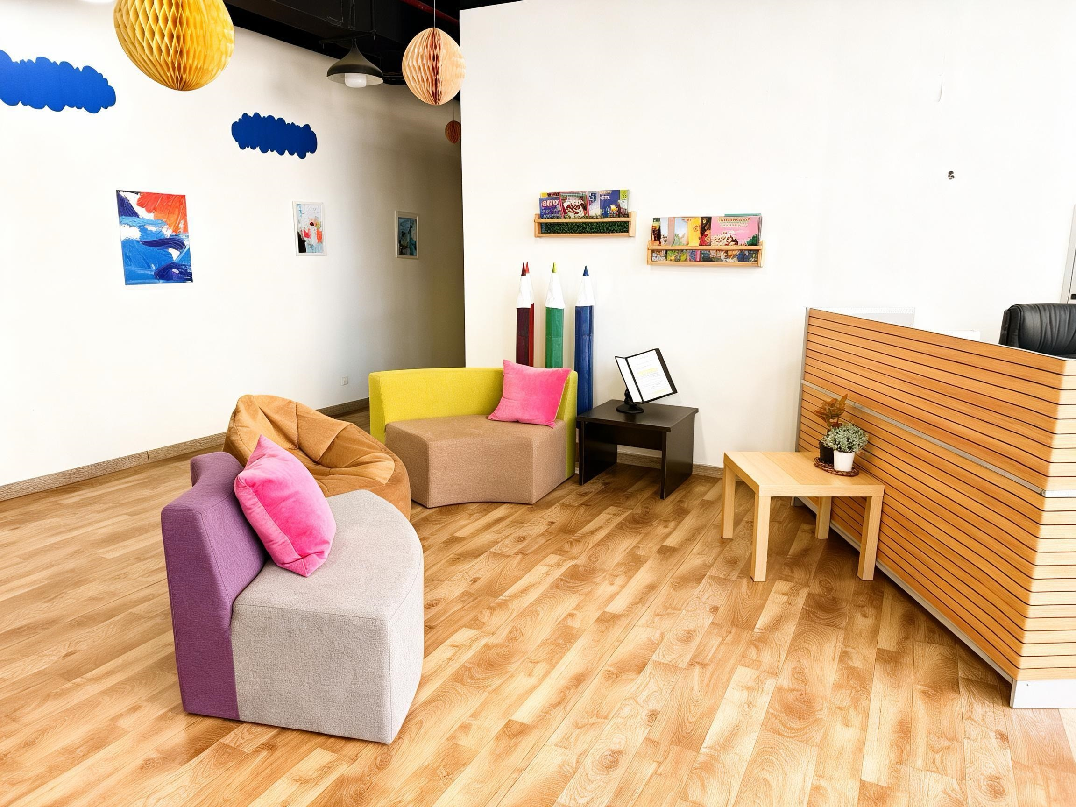
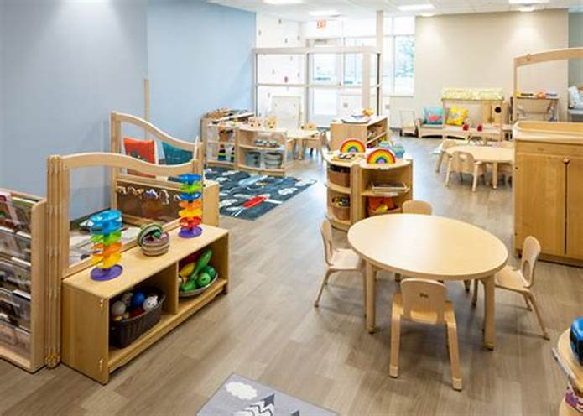
MARKETING REPORT
OUR BRANCHES
Playhouse Nursery proudly operates three branches across the UAE, located in both Abu Dhabi and Dubai.
Abu Dhabi Branches:
Al Khalidiya (Corniche): A prime residential area offering convenient access for families.
Al Reem Island Branch: One of the most prestigious and sought-after locations in the capital.
Dubai Branch:
Strategically located to serve families in a vibrant and family-friendly community.
Wherever you are, quality early years education is just around the corner!
TIMELINE
Page 9 of 10
Page 7

Slide 6
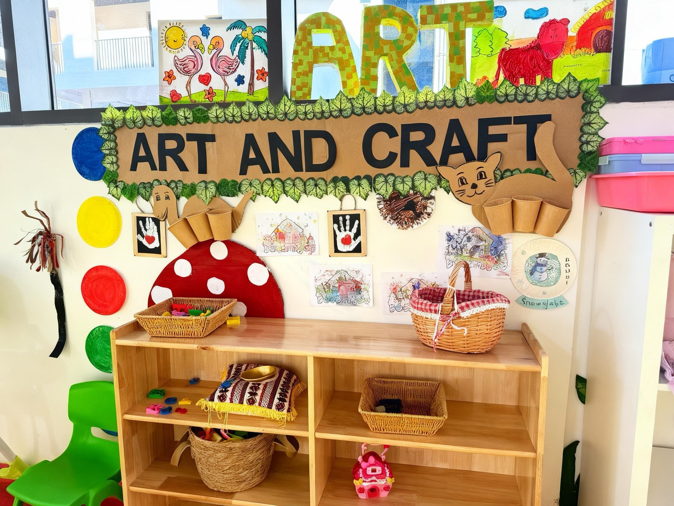
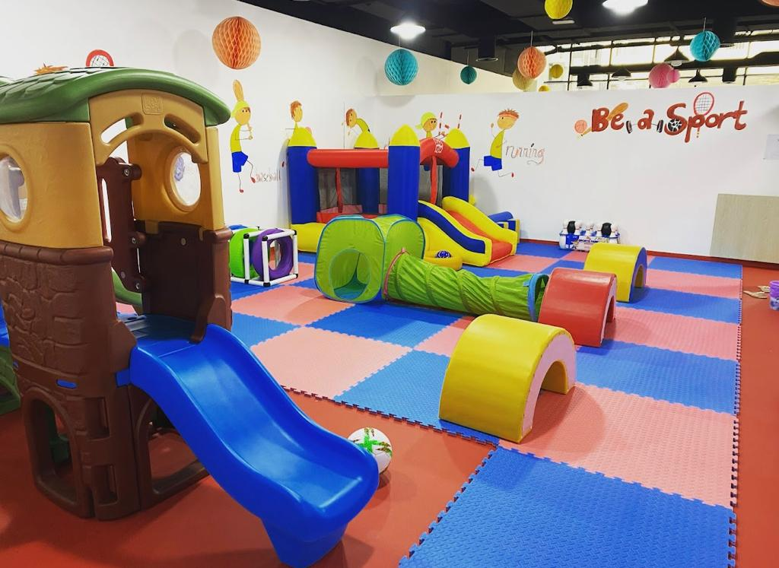
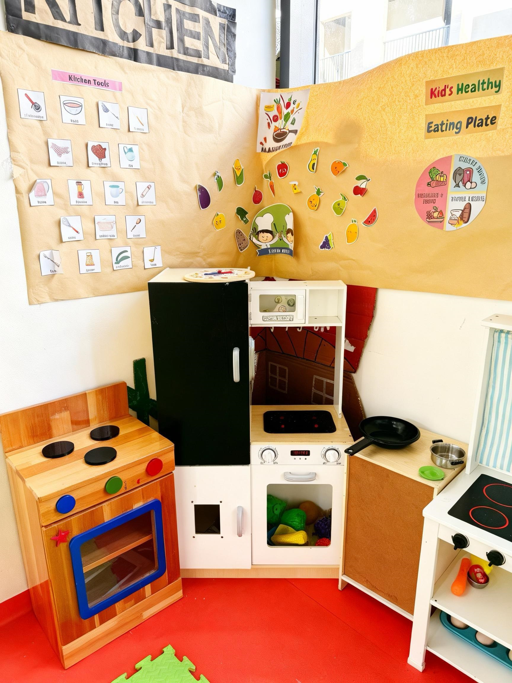
Playhouse Nursery's branches collectively accommodate around 150 children.
We proudly welcome children from diverse nationalities, creating a rich, multicultural learning environment.
Our settings provide a safe, nurturing and inclusive space where every child is valued and supported.
Role Play Centers at our setting:
- Designed to stimulate imagination and support creative development.
- Children explore real-life scenarios like:
- Home corner (kitchen, baby care)
- Grocery store / Market
- Doctor’s clinic / Hospital
- Construction zone
- Salon / Beauty corner
- Encourages:
- Language development
- Social skills & teamwork
- Problem-solving
- Confidence & independence
-
e

Slide 7
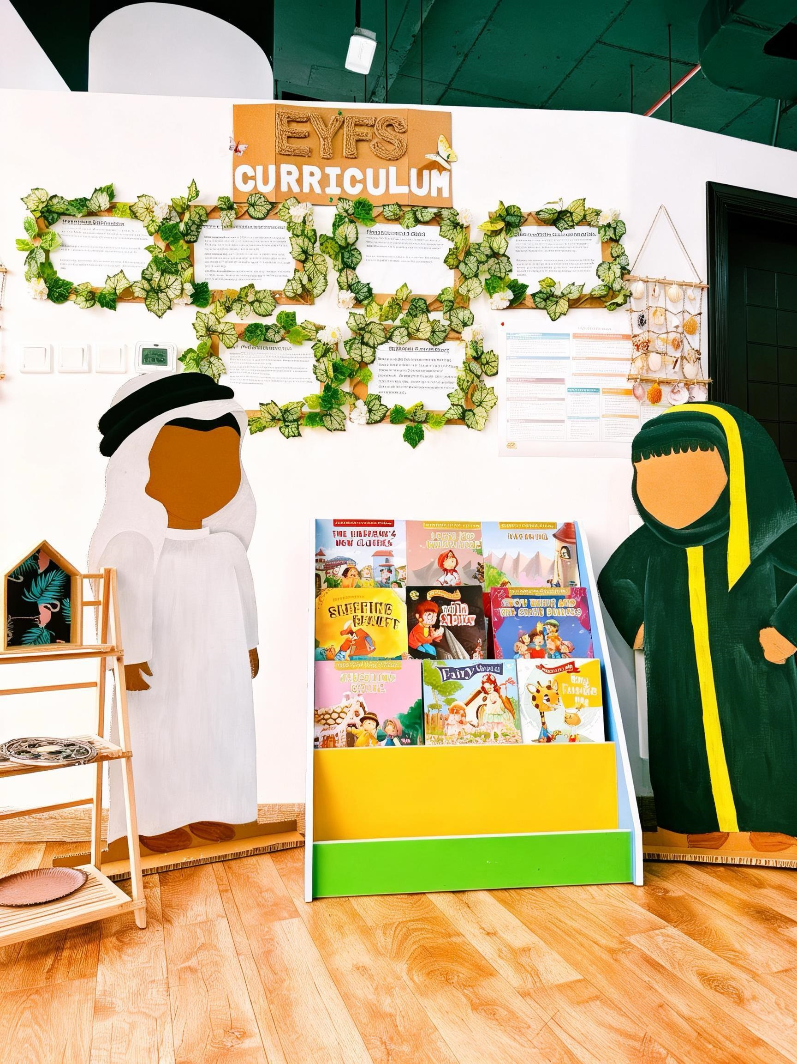
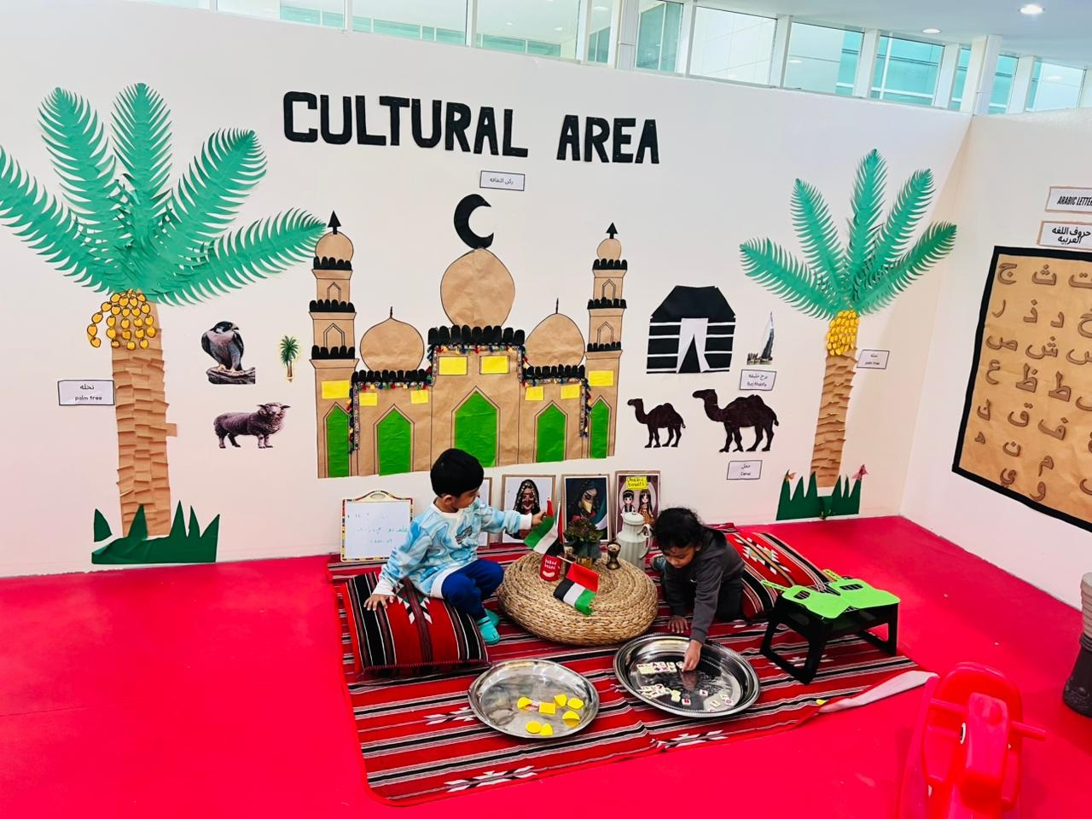
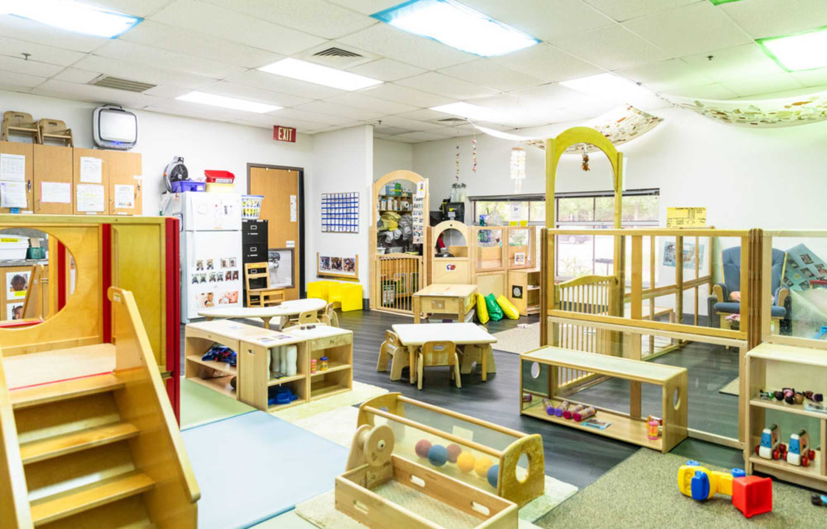
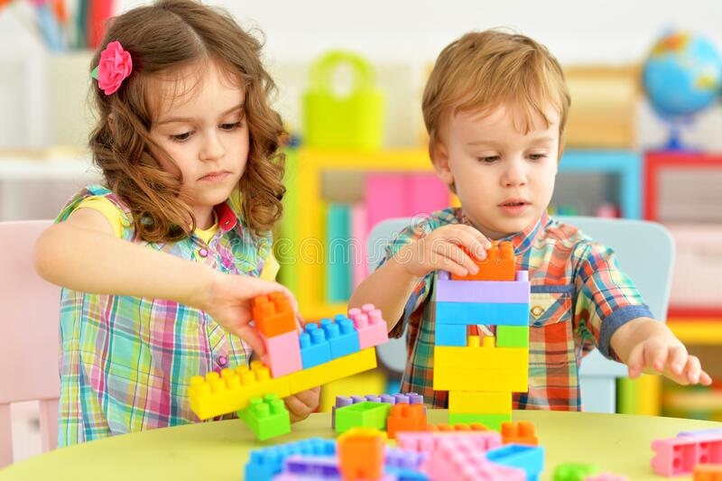
Reading & Literacy Corner :
- A cozy, quiet space that fosters a love for books and storytelling.
- Stocked with age-appropriate storybooks, picture books, and phonics resources.
- Independent reading
- Story time with teachers
- Puppet storytelling
- Letter recognition games
- Pre-writing and mark-making activities
- Supports EYFS Communication, Language & Literacy areas by developing:
- Listening and comprehension skills
- Vocabulary and phonemic awareness
- Early reading and writing confidence
- Encourages calmness, imagination, and a lifelong connection with reading.

Slide 8
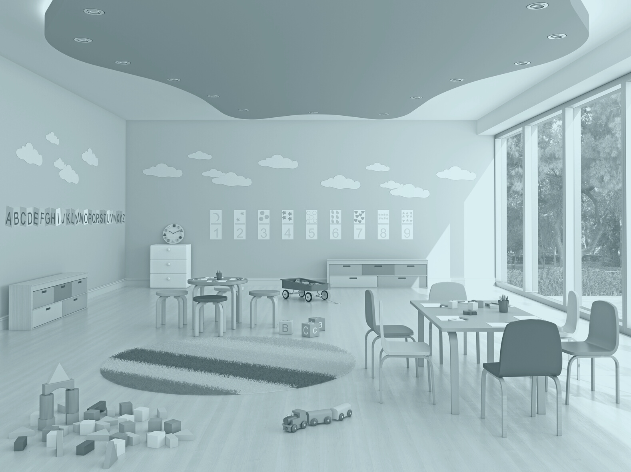
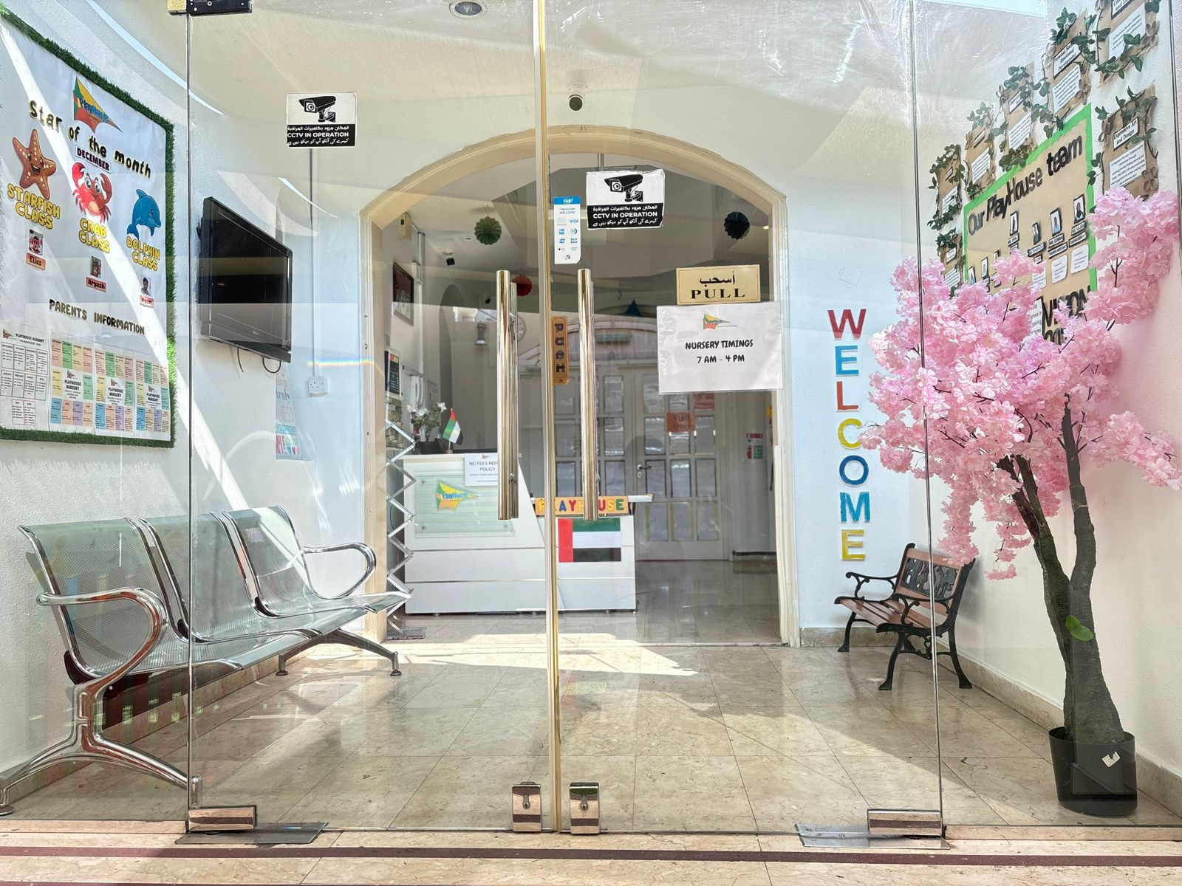
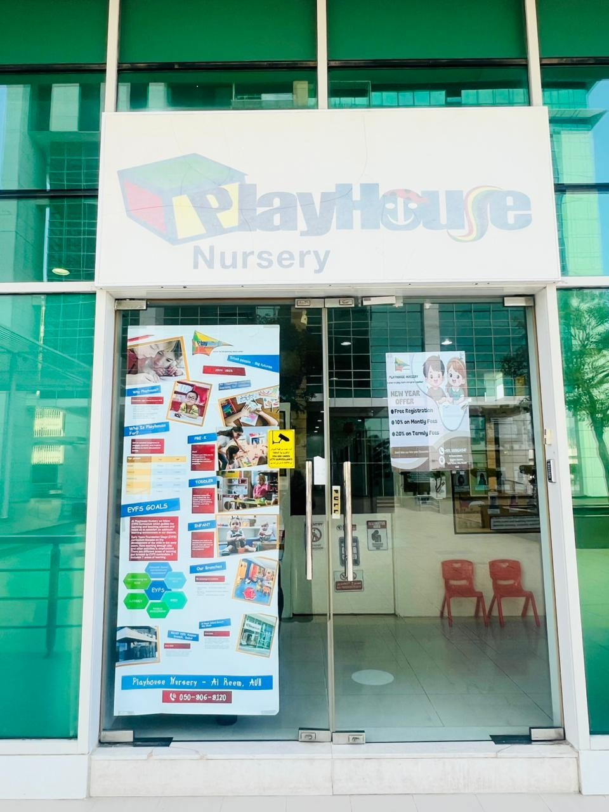
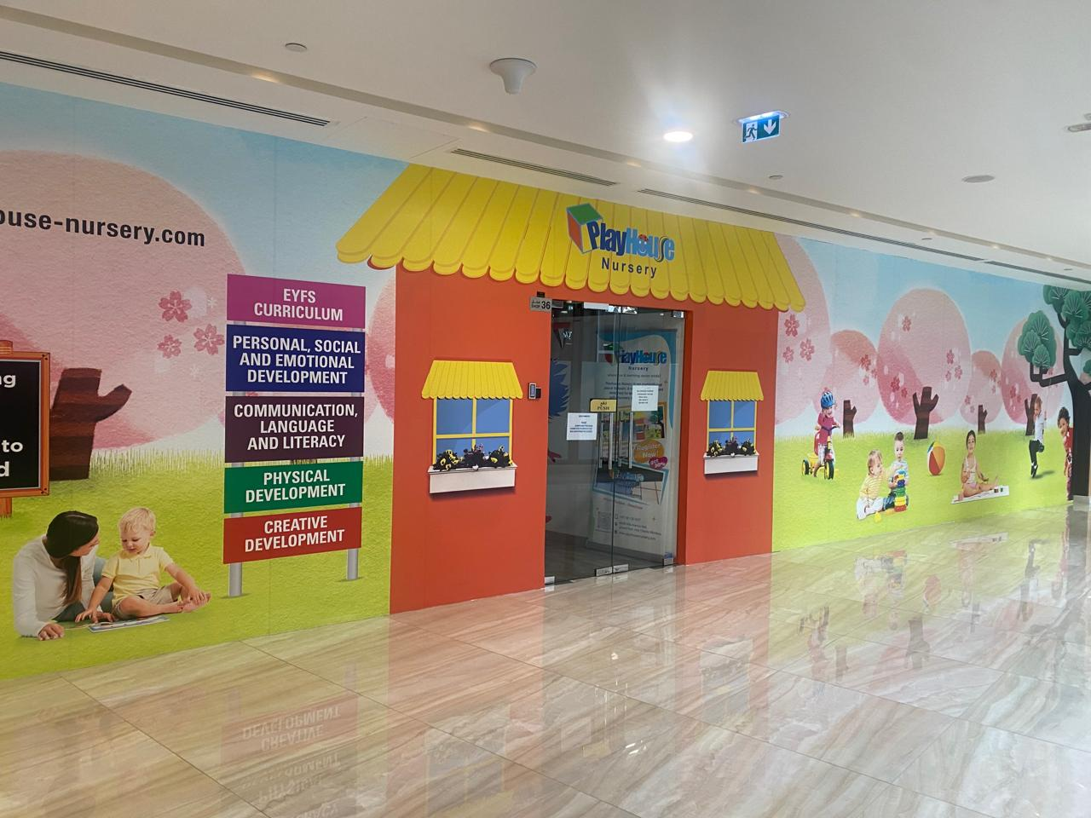
Our Early Childhood Centers:
★ Playhouse Nursery – Main Branch
📍 Al Khalidiya Street, Villa 11/8
Behind Sheraton Khalidiya Hotel, Abu Dhabi
📞 +971 54 263 2235
✉playhousenurserykhalidiya@gmail.com
★ Playhouse Nursery – Branch 1
📍 Al Reem Island, Marina Square, Tala Tower, Unit G-203
📞 +971 50 562 45 47
✉ playhousealreem@gmail.com
★ Playhouse Nursery – Dubai Branch
📍 Mirdif Hills Avenue Mall, Dubai
📞 +971 52 982 11 05
✉ playhousenurserymirdif@gmail.com

